Slide 1

LED Panel Clock
Cole Carrow
Ethan Brinser

Slide 2
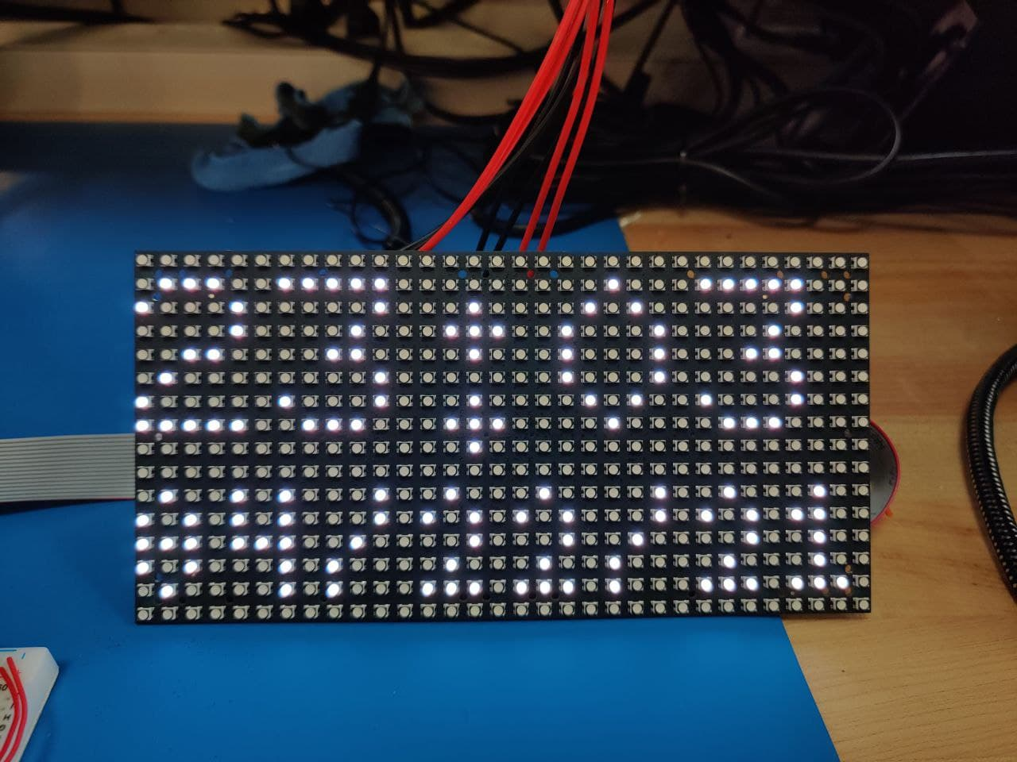
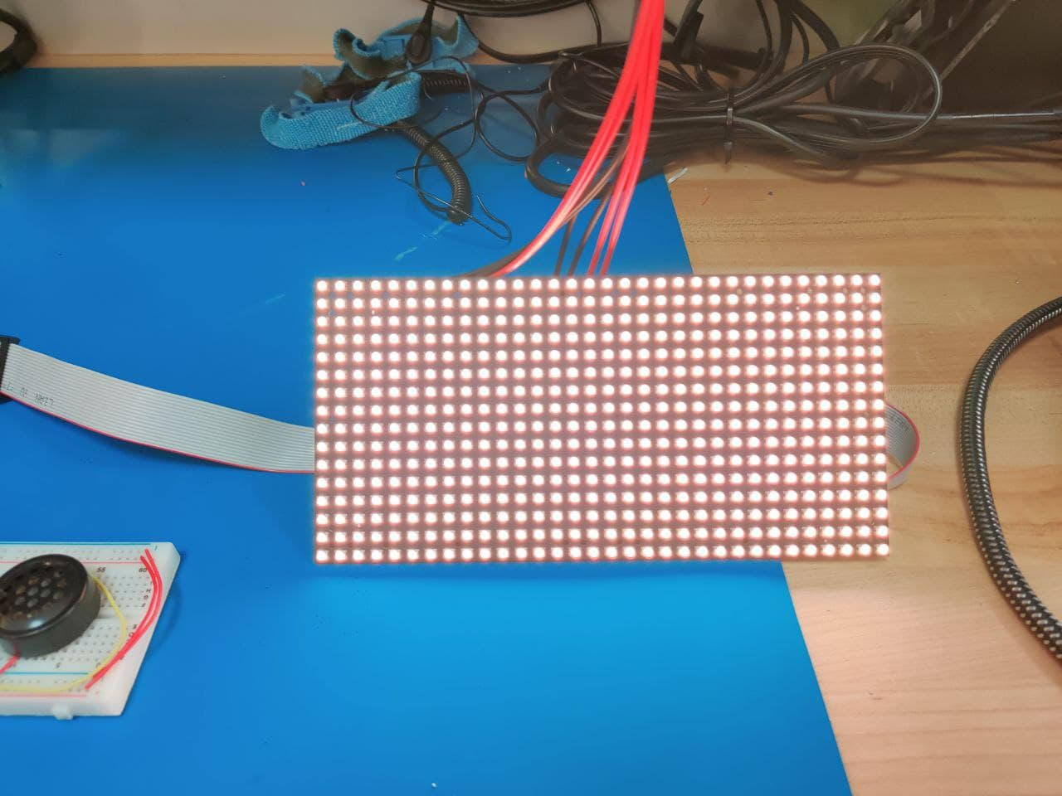
Features
Fully functional alarm clock
RGB pixel display
Visual alarm mimics sunlight
Backup audio alarm
Control with buttons or Bluetooth
Get time over WiFi

Slide 3
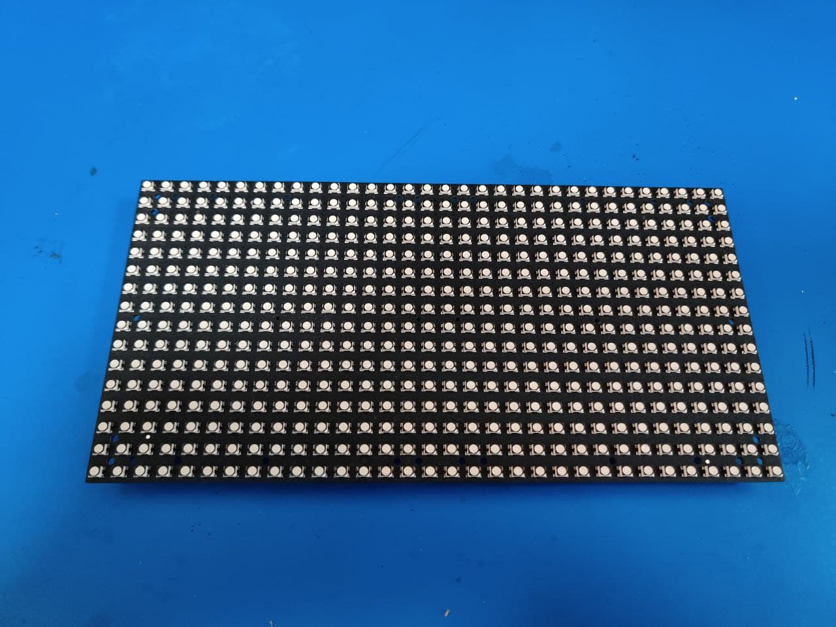
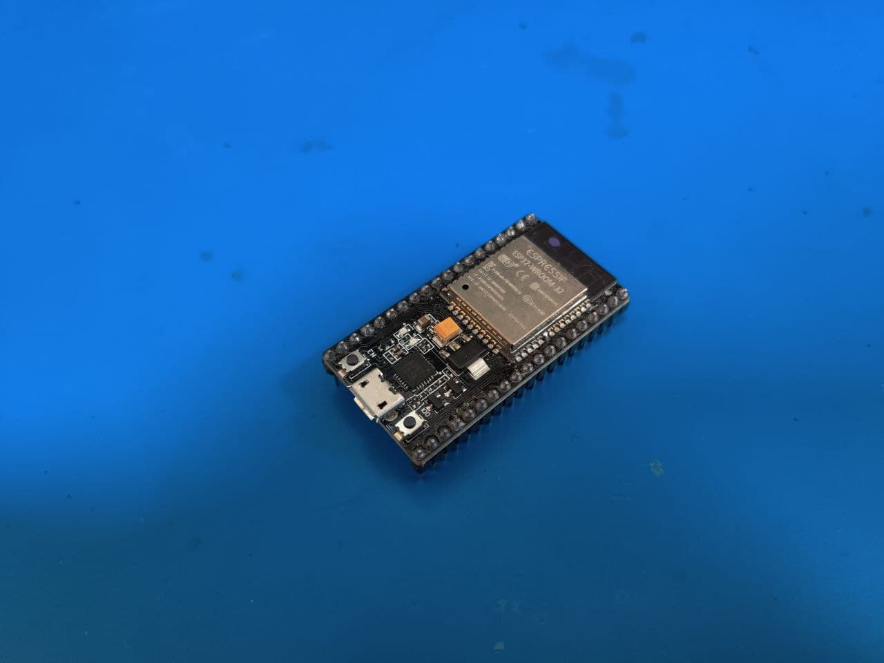
Parts used
ESP32 module
RGB LED Panel
4 push buttons
Speaker and driver
Power suply
Breadboard and cabling
Phone

Slide 4
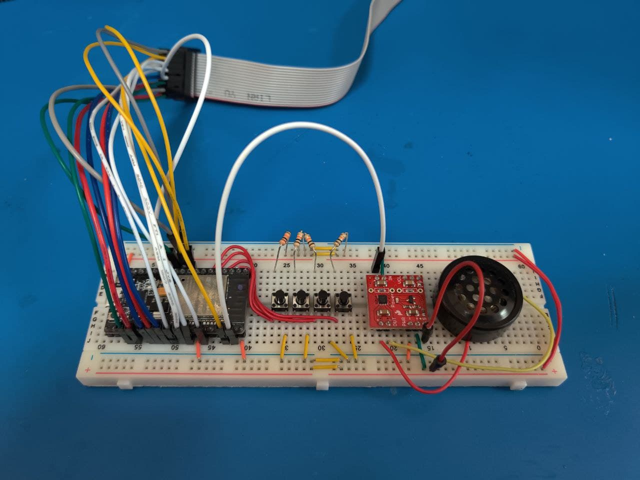
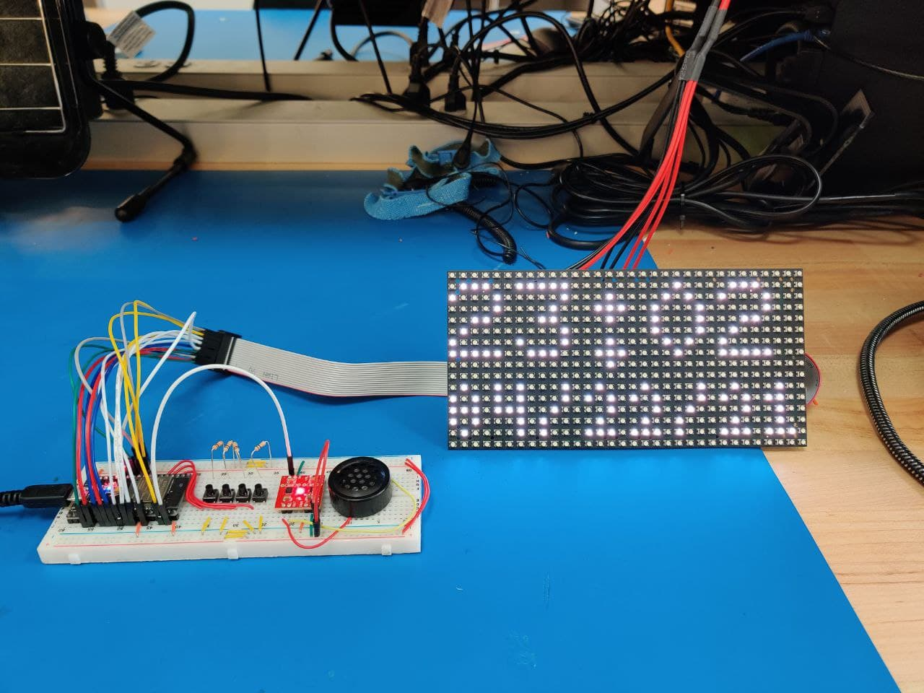
Photos

Slide 5
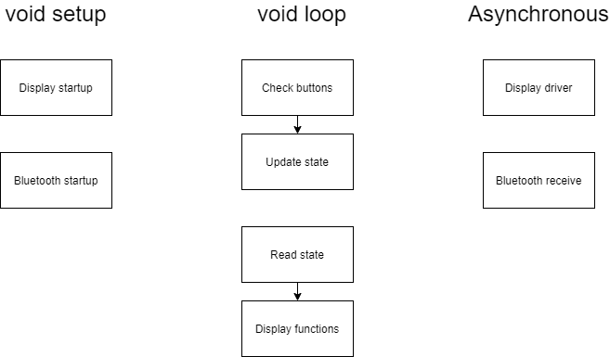
Program Structure

Slide 6
Software and Libraries
Arduino IDE
ESP32 library
SmartMatrix
Adafruit Bluefruit Connect App

Slide 7
Future Ideas
Save and reload settings on restart
Battery backup
Auto time zone detection
Color control
Multiple alarms
Larger display
Custom control app
Custom PCB and case

